Slide 1
Vendor Neutral Serverless Apps in Python/Zappa
Ram Vedam (@unxn3rd)
Atif Mahmood (@AtifDev)
Notes:
Introductions.

Slide 2
Agenda
Definitions
Serverless vs Traditional
Why Python + Zappa
Pitfalls to avoid
Zappa, Google AppEngine, and WSGI
Demo deployments
Advantages and Limitations
Notes:
Today we will start with covering some AWS Serverless specifics, and then target other clouds
I’ve deployed two ServerLess this year on AWS, so I will focus on AWS.
Define
Advantage over traditional HA applications
Python and Zappa
Pitfalls to avoid on AWS
Ram has dug into how Zappa and AppEngine work under the covers, will enlighten us all on WSGI,
He will demo how to deploy a simple Python RESTful API and without modification deploy it onto AWS, IaaS and Google Cloud.
He will discuss some advantages and limitations

Slide 3
Definitions
SaaS: Your just a user with little responsibility
PaaS: More on the vendor, less on you
IaaS: You handle all but the physical hardware
Monolith: Application with tightly coupled services
Microservice: Do only one thing, and one thing well.
Notes:
Infrastructure as a Service, Platform, and Software as a service
- Shared responsibility model
- As you go to the right, the vendor is responsible for more
- SaaS - Gmail - uptime, high availability, security
- PaaS- Hardware/VM/Patching/scalability, AWS’s problem
Heroku, App Engine, Lambda/Api Gateway
So over the last year, I’ve been working on server less application deployment at Chick-fil-A
I had the opportunity to look at an existing application that by all indications was following the example set forth in many AWS talks. However it had several problems and their were several lessons learned.
- Prefer Microservice vs Nanoservice. 1 Lambda per resource yields too many lambdas
- Don’t use the console for development - code in repo
- Prefer a framework, such as Zappa, to package and deploy
During my research on ServerLesss -> Mark Mandel from Google at last year’s Connect.tech and he made the point => Thats App Engine … and has been around for a decade
So Ram and I set forth to explore how one could go Serverless without vendor lockin. Today, we will discuss a design that allows you to start with ServerLess on AWS
- Cheapest
But maintain the flexibility to change hosing as Business and pricing changes.

Slide 4
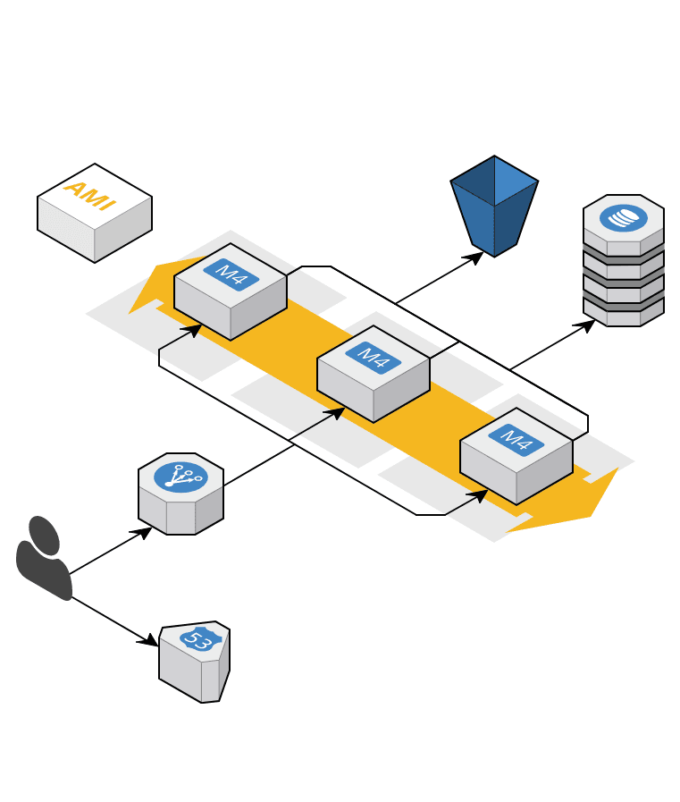
Traditional HA (EB)
Role based access
VPC
Load Balancer
Autoscale group
Security groups 2+
AZ and Regions
AMI to patch
Instances to babysit
Complex Packaging
Notes:
Tried and true architecture that everyone knows and loves…
Some of you may have arrived at this design using IaaS, others may recognize it as EB
Lots of items to maintain
EB & ECS -> still babysit base instance patching -> leverage Chef
Packaging - Burn AMI, or Docker Image
Large potential attack surface if mis configured

Slide 5
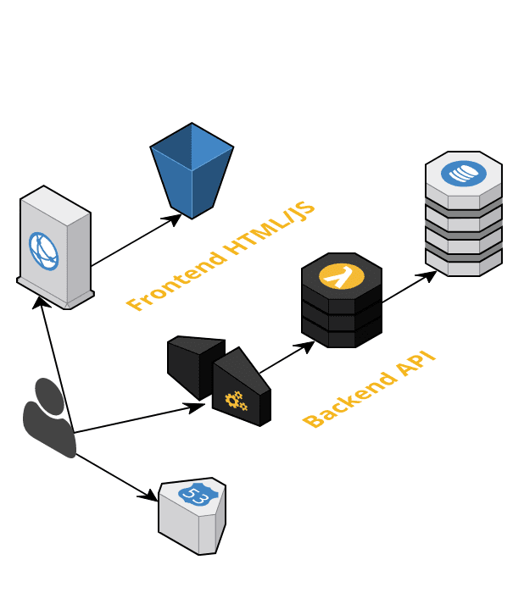
Serverless
Serverless Frontend
Serverless Backend
Role based access to AWS resources
Smaller attack surface
True PaaS
Notes:
First thing to note, is that their are fewer things to manage
Serverless Frontend - No Apache, or Nginix. CloudFront CDN, in front of you S3 bucket to get us HTTPS.
Cloudfront terminates your HTTPS
Your Angular or REACT goes here. The website is then shared by the CDN, which
makes it fast and a local hop.
Serverless backend - Api Gateway - > Calls your Lambda, starting container is necessary -> Role based dynamo access
With server less - Focus your application, and let Amazon figure how how to scale
up to 100 instances by default, very parallel
No AZ requirements,
Fewer or no security groups
No instances to babysit
Size a function based on memory. Larger memory - = larger instance with more cores

Slide 6
Why Zappa
Monolith — MicroService — NanoService
Cold start
Routing
Complex deployment
Console use
Unit testing
Difficult Debugging
Notes:
On the path to a Monolith, to a micro-service, we often overshoot to a nano service
- 30 + lambda to deploy
Complex deployment - Security Group, Api GW, Lambda, policies and roles
- Design the micro service. Maybe you take your POST that require an elevated role, and out the in another lambda. Then if the lower role lambda is compromised, you limit the potential damage

Slide 7
Suggested Approach
Build onto of a Python framework (Flask/Django etc)
Design what is included in the micro-service
Add zappa_settings.json to deploy on AWS
Add app.yaml to deploy on Google App Engine
User a Container or Instance for IaaS deployment

Slide 8
Vendor Neutral Architecture using Python/Zappa
Your application
Flask, Django, webapp2, etc.
Google AppEngine WSGI
mod_wsgi
Zappa - WSGI
AWS Lambda & AWS API Gateway
Apache
Google Cloud Platform
IaaS
Amazon Web Services
Notes:
High level diagram of our vendor neutral architecture
When incoming requests come in through Google AppEngine (through an appspot URL) or AWS API Gateway, request will be routed to the appropriate request handler on the running instance
Cold start if no running instances are available
It will come through call our WSGI-enabled application (more on this later) which will handle the request and return the response
Both Google Cloud and AWS (with Zappa) utilize WSGI for Python apps running on either lambda or GAE respectively

Slide 9
WSGI
Web Server Gateway Interface
Standardized in PEP 3333 in 2010
Used as specification for a universal interface for all web applications or frameworks
Used by many major web frameworks commonly used in Python
Django, flask, webapp2, etc.
https://wsgi.readthedocs.io for more information
Notes:
WSGI is the enabling specification that allows this to really happen
standard universal interface specification standardized as a PEP in 2003
how a web server communicates with web application
how web apps chain can be chained together to handle requests
For more info, suggest read https://wsgi.readthedocs.io

Slide 10
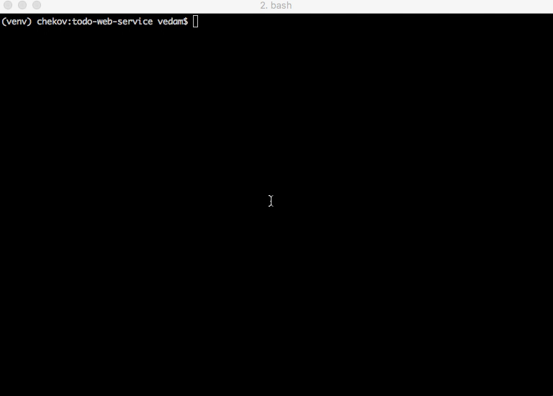
Demo
(AWS Lambda with Zappa)
Notes:
Once the Flask application is prepared, we can simply deploy our service to lambda by Zappa.
video steps:
zappa_settings.json - this created by “zappa init” which will do some initial setup not shown here but in next slide we will give an example output what is generated. Of course, you can follow the docs and write this JSON file yourself.
As of the current version of zappa: need to call zappa package dev to download external dependencies
Zappa has pre-packaged a bunch of libraries that are wrappers around C libraries to deal with the Lambda’s limitation of allowing only pure python libraries. These are found in the lambda-packages module that is installed when you do a virtualenv and install zappa.
zappa deploy
packages our application along with all dependencies to a zip file
creates a S3 bucket for project if it doesn’t exists.

Slide 11
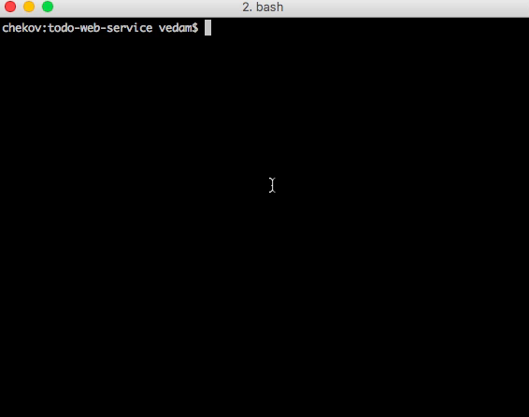
Demo (Google Cloud Platform)
Notes:
Similar deployment process for Google Cloud Platform
activate virtualenv environment
call google cloud cli to deploy app to app engine
initial deployment will upload more files than displayed in video. After initial deployment, only diff will be uploaded.
GAE will wind down previously deployed version of service and start up new version
call test services using tool of choice (here we are using curl)
not displayed: traffic splitting between different versions

Slide 12
app.yaml
runtime: python27
api_version: 1
threadsafe: true
service: default
instance_class: B1
basic_scaling:
max_instances: 1
idle_timeout: 5m
env_variables:
CLOUDSQL_CONNECTION_NAME: todo-web-service-dev:us-east1:todos
CLOUDSQL_USER: <username>
CLOUDSQL_PASSWORD: <password>
libraries:
- name: MySQLdb
version: "latest"
handlers:
- url: /.*
script: todos.app
Notes:
Sample of our app.yaml
Similar to Zappa, we have to specify the runtime our application needs to run on
the api_version in the app.yaml represents the version of the google api that will be required when deploying. When using GAE standard, this is always set to 1
the “service” name is the name of the microservice that will be deployed. All projects require a “default” top level service before creating sub-services
You can also specify your scaling policy here. GAE standard supports basic, manual, and automatic. basic and manual of some similarities and basic and automatic have similarities that are mainly due to how instances are shutdown when idle, how to scale out when more requests come in, etc.
One thing to note here is the libraries section. This is indicating to GAE what additional libraries outside the Google version of the Python standard libraries are needed to deploy application.
finally the handlers are the request handlers that are invoked when web requests come in. In this case, all requests are forwarded to our Flask application.

Slide 13
Gotchas
Google Cloud Platform
can only use Google App Engine Standard for Serverless apps with Python
can only use Python 2.7 when deploying on GAE standard
AWS
Using IAM_AUTH with signed s3 bucket url’s doesn’t work
Frequency <50ms requests in succession, expensive
Notes:
A couple of gotchas with this architecture:
currently only GAE is available option when developing server less apps with Python
Google Cloud Endpoints w/ Google Cloud Functions currently only supports development with JS
Python 2.7
If wanting use latest Python version, one can use Google App Engine Flexible but there are some

Slide 14
Advantages and Limitations
Advantages
Requires only either a zappa_settings.json (AWS) or a app.yaml (GCP) for deployment
Limitations
Deployable on any cloud platform that supports Python Flask using WSGI (currently only Google Cloud and AWS)
Limited to Pure Python dependencies when using Google Cloud AppEngine Standard. There may be alternative libraries based on what you are using

Slide 15
Zappa Serverless Architecture
No upfront provision
No Servers to babysit
Almost no Security Groups
VPC’s optional
No Auto scale groups
No Ami’s to maintain
No instances to patch
Pay per use in 100ms increments
Reduced time to market
Reduced Cost
Invest in the core competency
Group your code
Pay for slow start less often
Debug locally
Smaller attack surface
Lower share of responsibility
Notes:
To Summarize

Slide 16
Questions??
Url: https://github.com/Miserlou/Zappa
slack: slack.zappa.io
Ram Vedam (@unxn3rd)
Atif Mahmood (@AtifDev)

Slide 17
Coldstart in AWS
Language | Cold Start Large - Small | Usable Size | Frameworks
Python (2.7/3.6) | 0.3 - 3 ms | Any | Zappa (Flask/Django), Chalice
Node 6 | 2 - 36 ms | Any | ServerLess
Java 8 | 425ms - 4000ms | 1.5G | -
C# | 694ms - 5000ms | 1.5G | -
Note: Times are before framework initialization. See below for details https://read.acloud.guru/does-coding-language-memory-or-package-size-affect-cold-starts-of-aws-lambda-a15e26d12c76
Notes:
Thing to note here is that
Java and C# are in the same ballpark for their slow start. Both require large instances to bring cold start times into a reasonable sub 1 second area, and both would require
Node is 2 orders of magnitude faster than Java and C#
Python is an additional order of magnitude faster than Node, making it 3 orders of mag after than Java/C#
As a result, cold start isn’t really a concern and for most applications, the default on demand behavior is sufficient.
Please see a cloud guru for more details.
In Google App engine, cold start is also something to consider, but is outside the scope of this talk.

Slide 18
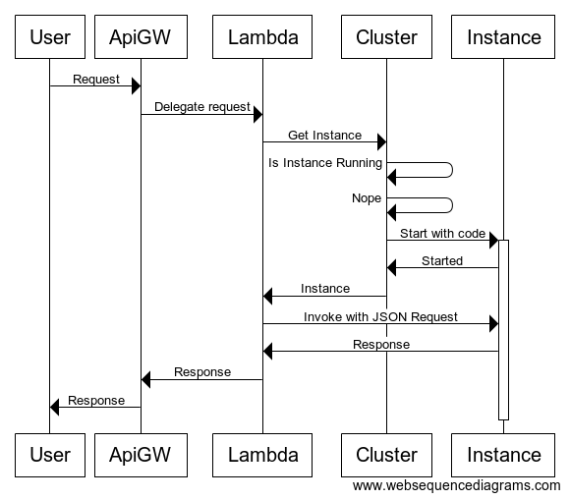
Serverless: Cold Start
Notes:
One Concern with Lambda is cold start, so lets describe a bit about how Lambda works
Not meant to be accurate, but just to illustrate cold start
User->ApiGW: Request
ApiGW->Lambda: Delegate request
Lambda->Cluster: Get Instance
Cluster->Cluster: Is Instance Running
Cluster->Cluster: Nope
Cluster->+Instance: Start with code
Instance->Cluster: Started
Cluster->Lambda: Instance
Lambda->Instance: Invoke with JSON Request
Instance->Lambda: Response
Lambda->ApiGW: Response
ApiGW->User: Response

Slide 19
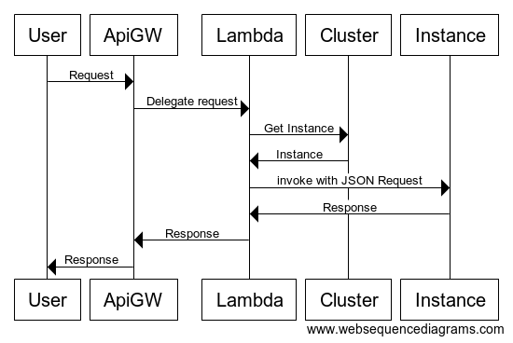
Serverless
Notes:
Here, the instance is already up, so instead of spending the time to start an instance on the cluster, it just delegates to the instance

